Slide 1


Investment Prediction System
Name: Suraj R Kakulte
Internship: Online Mode
Company Name: PWC Pvt. Ltd.

Slide 2

Introduction
Welcome to the world of predictive analytics in the stock market! In this presentation, we will show you how to use data to make informed decisions and reap the rewards of the stock market. Join us on this journey as we uncover the secrets of the stock market.
Stock prices are difﬁcult to predict. However, data-driven approaches offer new opportunities to gain insights and make informed decisions. In this presentation, we will explore some of the techniques used to predict stock prices.

Slide 3

Historical Data
One of the most common approaches to predicting stock prices is to analyze historical data. By examining trends, patterns, and other indicators, we can gain insights into how a stock may perform in the future. However, this approach is not foolproof and requires careful analysis and interpretation.

Slide 4

Objective
To predict future stock prices using machine learning algorithms (ARIMA, LSTM, Linear Regression) and provide actionable insights based on Twitter sentiment analysis. The project also offers visual dashboards and an interactive web UI for user interaction.

Slide 5


Benefits
Provides early insights into market trends.
Helps investors make informed decisions.
Combines technical and sentiment analysis.
User-friendly dashboard for non-technical users.
Real-time and historical data integration

Slide 6
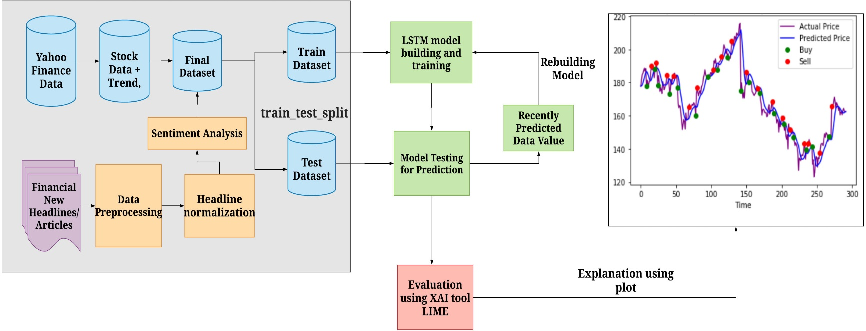
Architecture

Slide 7


Architecture Description
Data Collection:
Real-time stock data (Yahoo Finance), Tweets (Tweepy- API)
Data Preprocessing:
Clean, normalize, label sentiment
ML Models:
ARIMA, LSTM, Linear Regression
Sentiment Analysis:
Vader and TextBlob for tweet classification
Web Interface:
Flask backend with HTML/CSS frontend
Dashboard & Visualization:
Matplotlib, Plotly

Slide 8
Technology Stacks
Languages: Python, HTML, CSS, JavaScript
Libraries: yfinance, LSTM (Keras), scikit-learn, tweepy, VaderSentiment
Web: Flask (Backend), WordPress (CMS), Chart.js
Database: MySQL
Visualization: Matplotlib, Plotly

Slide 9
Key Features
Predict stock prices for next 7 days.
Visualize actual vs predicted values.
Analyze sentiment from Twitter.
User authentication system.
Clean and interactive web UI.

Slide 10
Pros & Cons
Pros:
Multi-model prediction improves accuracy
Integration of sentiment analysis for better context
Custom UI enhances accessibility for users
Modular structure allows future expansion
Cons:
Limited accuracy in highly volatile markets
Dependency on third-party APIs (Twitter, yfinance)
Requires regular updates to stay relevant

Slide 11
Conclusion
Predicting stock prices is a complex and challenging task that requires careful analysis and interpretation. While no approach is foolproof techniques, data-driven methods provide new opportunities to gain insights and make informed decisions. Combining models with quality data boosts prediction accuracy. The system enables investors and analysts to gain insights into future stock trends based on a combination of historical data and public sentiment. The integration of ML with sentiment analytics makes predictions more robust and user-centric.

Slide 12


Thanks

